Slide 1
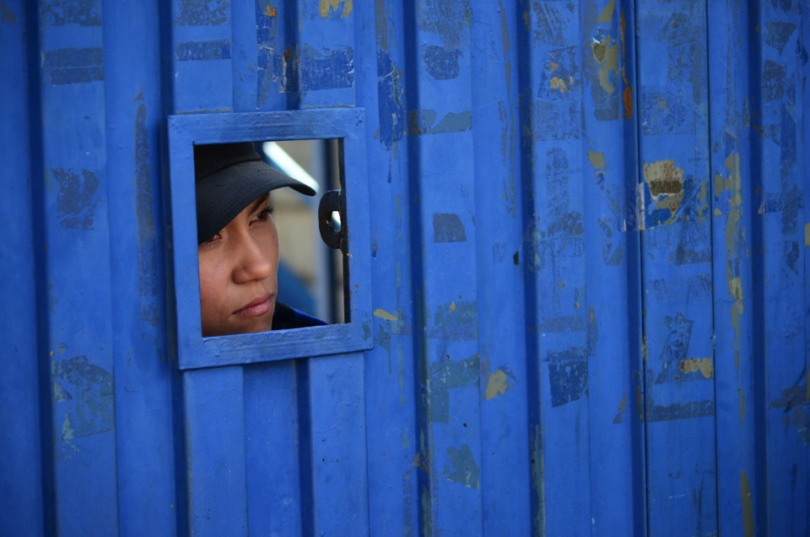
Women, Drug Policies and Incarceration
A Guide to Policy Reform in Latin America and the Caribbean

Slide 3
Women, Drug Policies and Incarceration
Incarceration as a response to drugs has a disproportionately negative impact on women.
Their incarceration contributes little if anything to dismantling illegal drug markets or improving public security.
Prison limits chances of finding employment when released from prison.
Perpetuates a vicious cycle of poverty, involvement in drug markets, and incarceration.

Slide 4
Women, Drug Policies and Incarceration, cont.
Incarceration of women, caregivers in particular, can have devastating consequences for their families and communities.
Dependents are often abandoned and marginalized.
Increases the likelihood of persons in their care consuming drugs or becoming involved in illegal trafficking networks.

Slide 5
Working Group Members: 10 Countries
Argentina
Brazil
Chile
Colombia
Costa Rica
Ecuador
United States (including Puerto Rico)
Mexico
United Kingdom
Uruguay

Slide 11
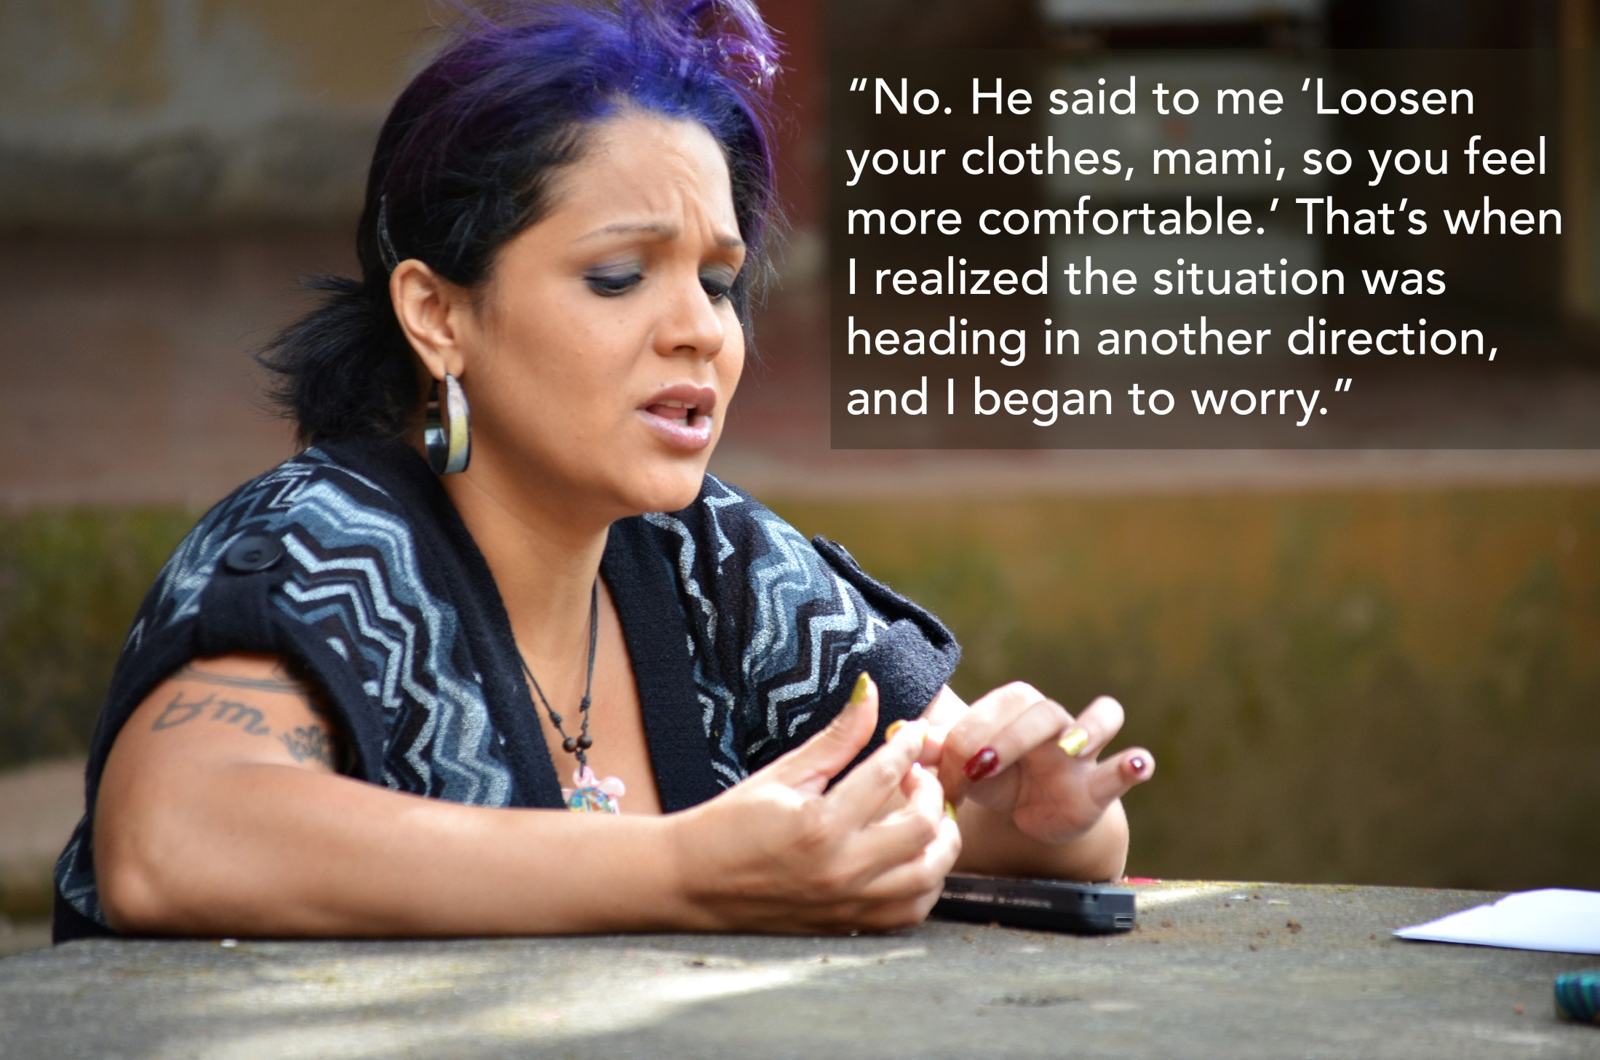

Slide 15
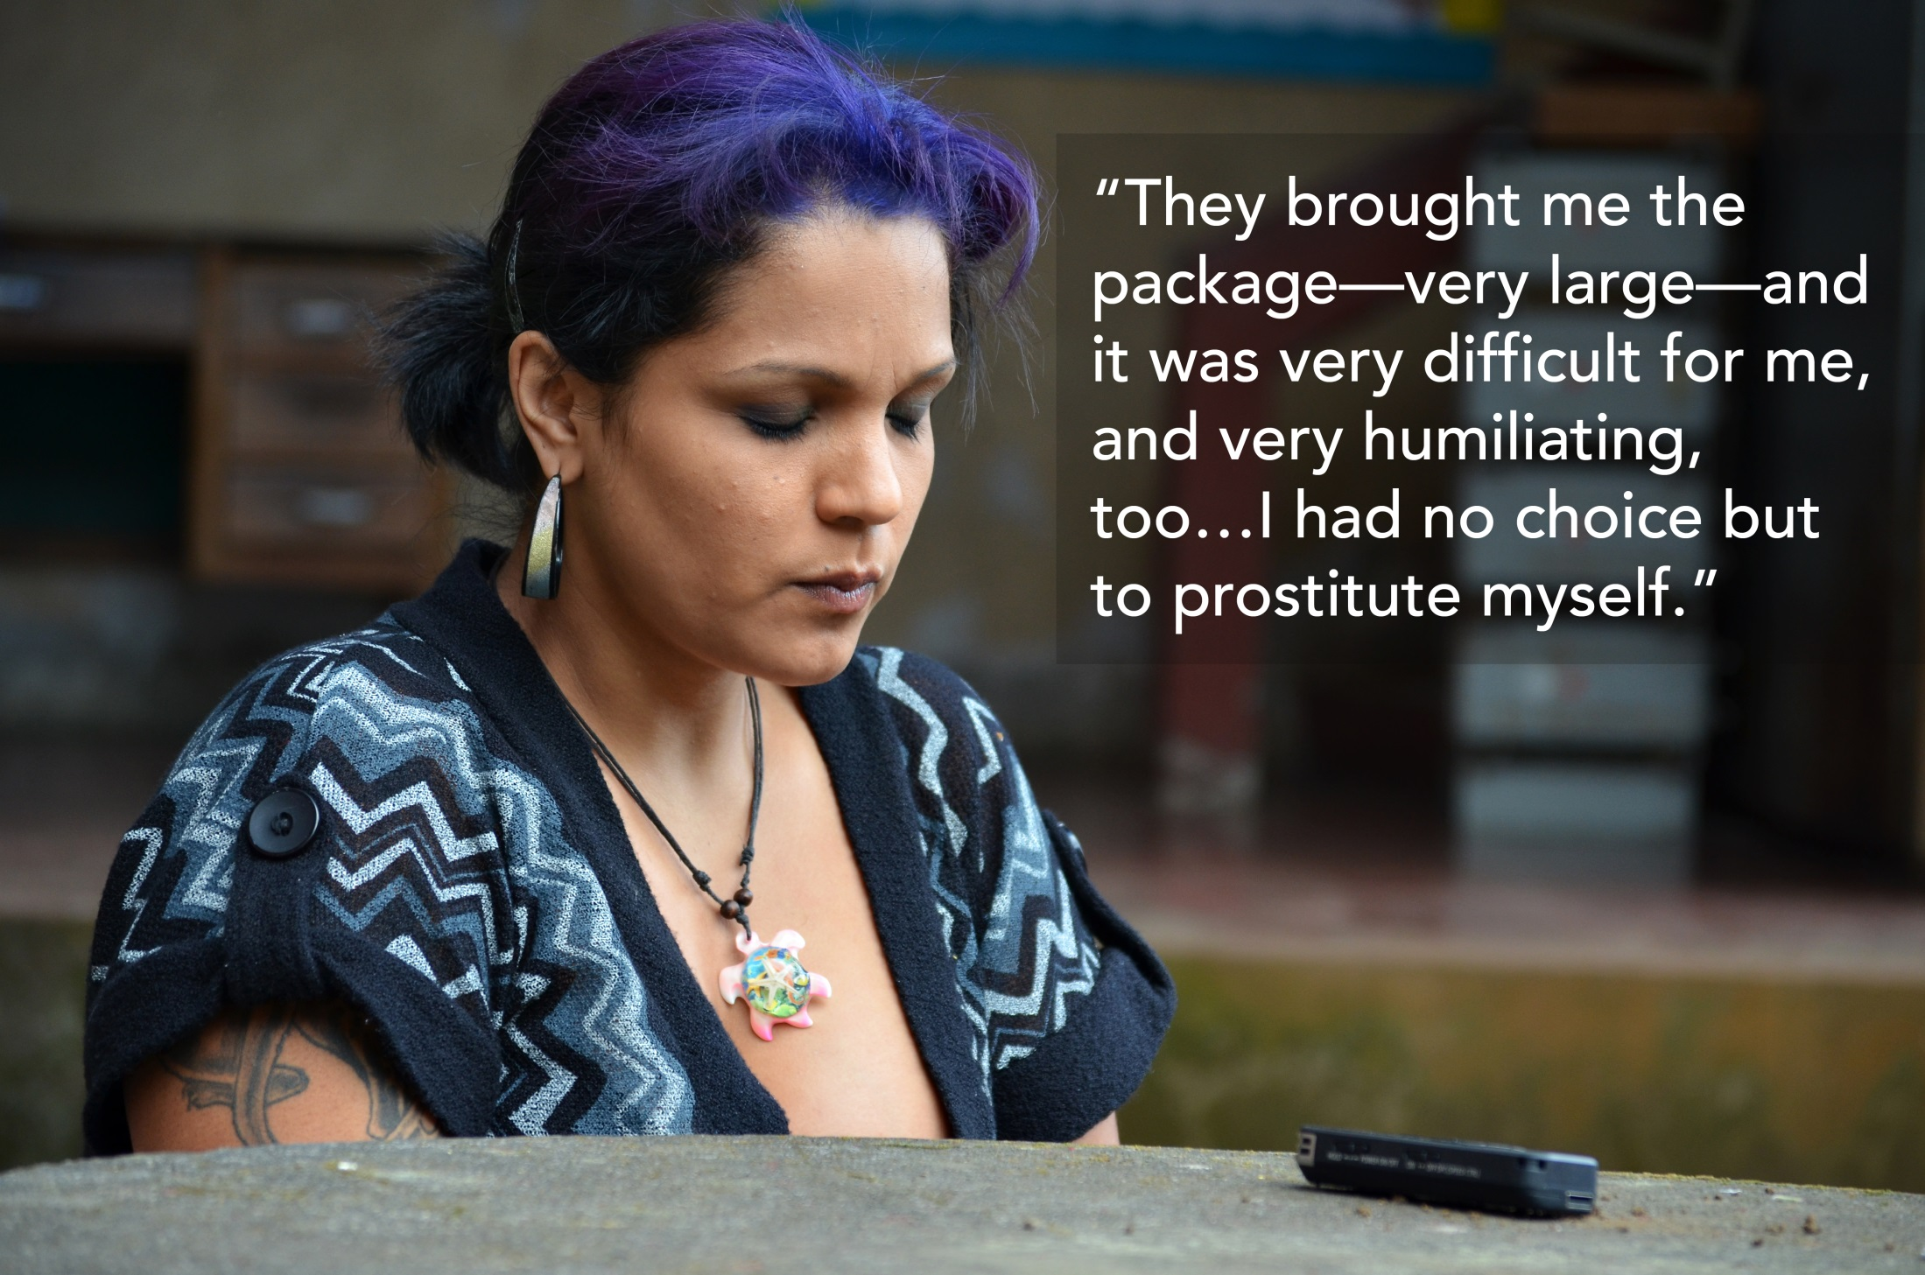

Slide 21
Guide: Overview and Objectives
To reduce the female prison population in the region.
Current drug control policies have led to excessive criminalization and incarceration of women, and such policies need to be reconsidered from their foundations.
Recommendations on the issue of women incarcerated for drug offenses in Latin America and the Caribbean.
Does not encompass issues affecting the general prison population, though it refers to pregnant women and mothers, since the vast majority of women in prison for drug offenses are single mothers.

Slide 22
Women’s Incarceration: An alarming increase
Women in the Americas are being incarcerated for drug-related offenses in alarming numbers, with some of the highest global incarceration rates, along with Asia.
Incarceration of women is growing at a faster pace than men. The population of women prisoners in Latin America has climbed 51.6 % between 2000 and 2015, compared to 20 % for men.
The driving forces behind these exorbitant rates of incarceration are the adoption of extremely punitive drug laws and the imposition of disproportionate penalties.
In Argentina, Brazil, Costa Rica, and Peru, more than 60% of women prisoners are behind bars for drug-related offenses.

Slide 23
Guiding Principles for Policies and Action
Criminal justice should be used only as a last resort.
Gender mainstreaming needs to be incorporated when developing, implementing, and evaluating reforms to drug laws and policies.
In order to minimize their side effects, drug policies should take into account the differential and incremental impact of their application on women and their families.
Women, especially those incarcerated or formerly incarcerated, should be given a fundamental role in designing, implementing, and evaluating drug policies.

Slide 24
Guide to Policy Reform: Seven Specific Categories
More inclusive drug policies
Drug policy reforms
Alternatives to Incarceration
Cultivation and drug processing
Social inclusion programs
Women who are pregnant or have dependents
Data collection and analysis

Slide 25
Drug Policy Reforms
Five areas of focus:
Decriminalizing drug use;
Proportionality in sentencing;
Pardons, amnesties, commutation and retroactive reduction of sentences;
Human couriers and foreign women;
Pretrial detention.

Slide 26
Decriminalising drug use
Criminalization of drug users persists. The stigmatization of drug users is a constant violation of their fundamental rights.
Women are even more stigmatized for using drugs.
The use, possession, and cultivation of drugs for personal use should be decriminalized; criminal prosecution should not be used in these cases.

Slide 27
Proportionality in Sentencing
Distinguish between: (i) low-level, mid-level, and high-level drug offenses; (ii) one’s rank in the criminal network; and (iii) violent and non-violent offenses.
Eliminate mandatory minimum sentences.
Legal frameworks allow for the possibility to reduce sentences and promote alternatives to incarceration.
Several factors should be considered, including: poverty and social exclusion, caregiver status and role as head of household, level of education, gender violence, among others that may have contributed to the engagement in criminal conduct.

Slide 28
Human Couriers
Human Couriers, or ‘mules’ usually have no prior criminal record and many are foreign women. Used by organized criminal groups, the ones who really profit from these illicit activities.
Argentina shows 9 in 10 foreign women in prison for (federal level) drug offenses were human couriers; 96% were first-time offenders.
Facilitate the transfer of foreign women, so that (with their consent) they can serve their sentences in their home country

Slide 29
The Excessive use of Pre-Trial Detention
Many drug laws mandate Pre-trial detention regardless of the level of the drug crime.
Eliminate the obligation to hold those accused of drug-related offenses in pretrial detention.
Do not use pretrial detention for pregnant women or women with dependents. In such cases, house arrest or supervised release should be used, such that the fundamental rights of the offender and her family are not violated.

Slide 30
Alternatives to Incarceration: A gender Perspective
Alternatives to incarceration should:
Be aimed at providing more humane and effective responses to drug-related offenses.
Reduce the negative impacts and consequences of imprisonment, while limiting the use of criminal sanctions.
Focus on the economic autonomy and social integration of women.

Slide 31
When Implementing Alternatives
Remove all legislative and practical obstacles that keep those who commit drug offenses from benefiting from non-custodial measures or from being granted a suspended sentence, probation, or parole.
Guarantee every woman who is a first-time offender of a minor drug-related offense entry to programs outside the criminal justice system that make it possible to prevent any new offense from being committed with the support of a multisectoral network.

Slide 37
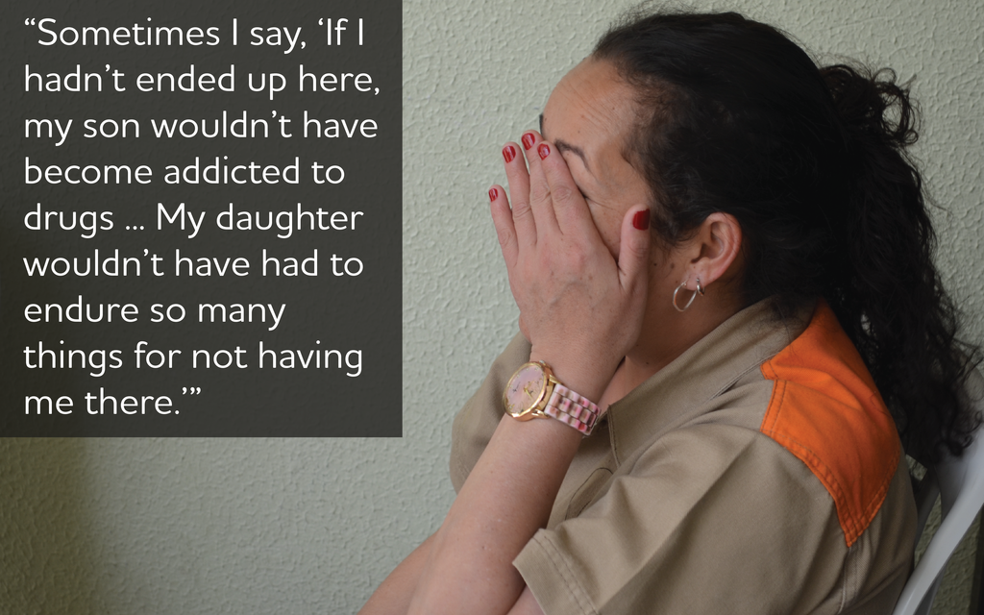

Slide 39
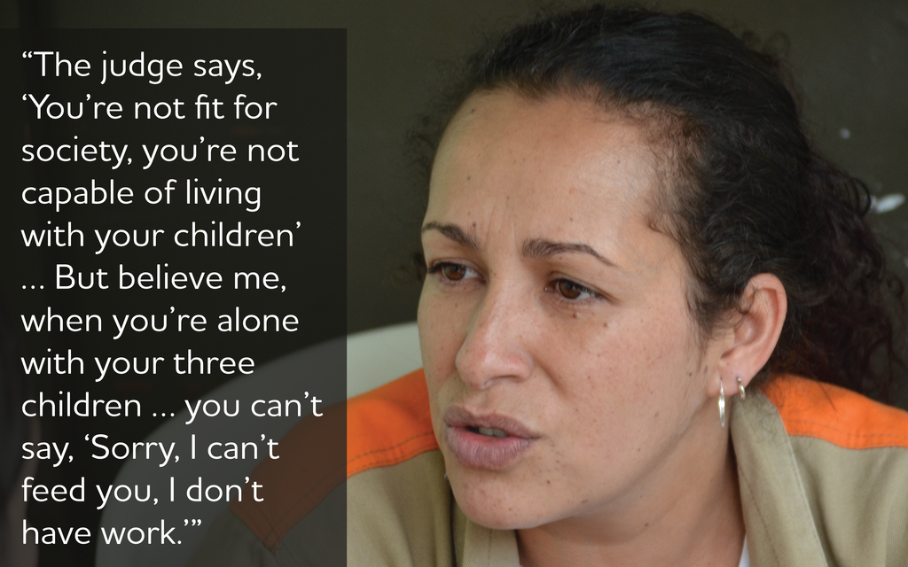

Slide 42
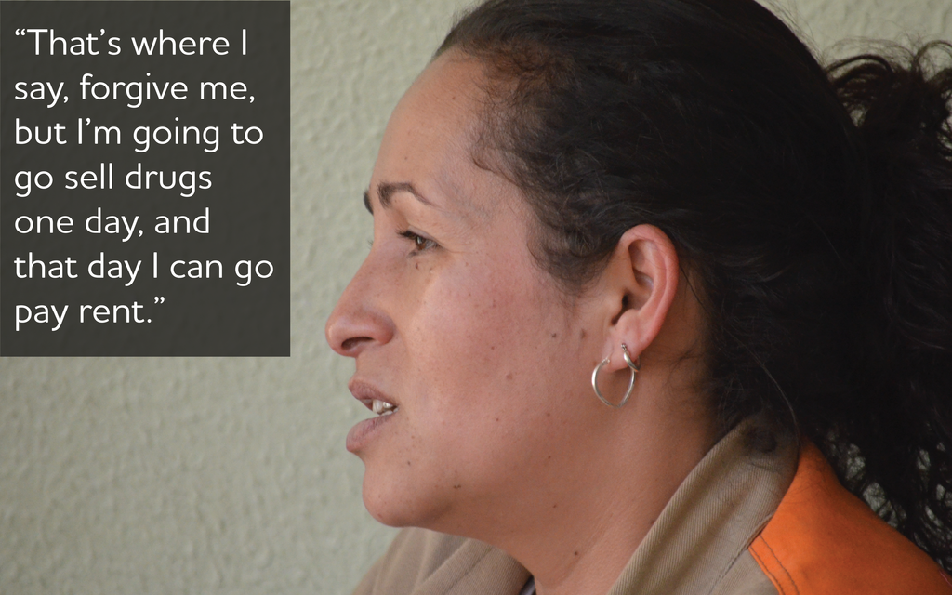

Slide 43
Pregnant women and women with dependents
In no case should pregnant women or mothers of minor children who have been detained or convicted of non-violent drug offenses go to prison. Alternative measures should be adopted.
Avoid discrimination against and criminalization of mothers and pregnant women who use drugs. In particular, avoid: mandatory confinement, loss of custody of one’s children, criminalizing women for interrupting pregnancy, negatively impacting their sexual and reproductive health, and forced treatment for drug use.

Slide 44
Additional resources to the Guide:
A report on alternatives to incarceration with a gender perspective.
A compilation of innovative approaches related to the issues addressed in the guide.
A more detailed proposal on data collection and analysis.
A series of photo-essays of women deprived of liberty for drug offenses.

Slide 45
Thank you!

