Slide 1



Economic Valuation of the Montego Bay Marine Park
Methodology Test Cases

Slide 2
Economic Valuation
What?
  A means to estimate the value of environmental resources
How?
  Different methodologies exist
    Total economic value = direct-use value + indirect-use value + non-use value
      Direct – Earnings dependent on the resource (tourism, fishing)
      Indirect – biological support, physical protection
      Non-Use – option/existence, general knowledge that a resource will still be in place for the next generation
Why?
  Consider Conservation vs Development…
  Development quantified in economic terms; Conservation traditionally qualified in qualitative or scientific terms.
  Economic Valuation provides us with a means to present environmental values in the same way development projects are presented.
  Apples for Apples
Notes:
What is Economic Valuation?
A means to estimate the value generated by a particular ecosystem service towards the local economy.
How is it calculated?
Different methodologies use different approaches. As you will see here, one is GIS based (Value Transfer), the other strictly financial based.
What Purpose does it serve?
Provides us a means to incorporate environmental considerations into legal, financial and policy considerations.

Slide 3
Purpose of the exercise
Complete three economic valuation methodologies
Garner peer input
Feed outputs into national/international databases
Adjust tools?
Promote wide-scale adoption of selected methodology

Slide 4
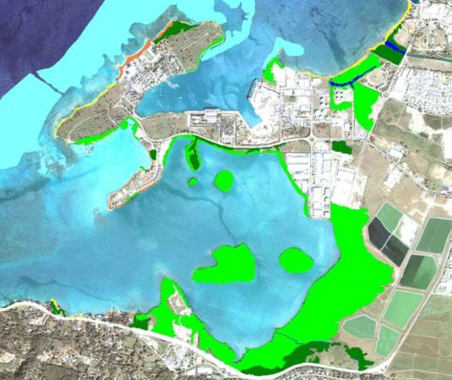
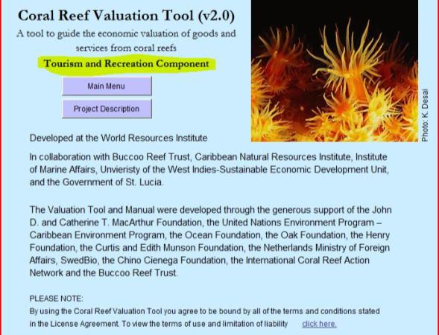
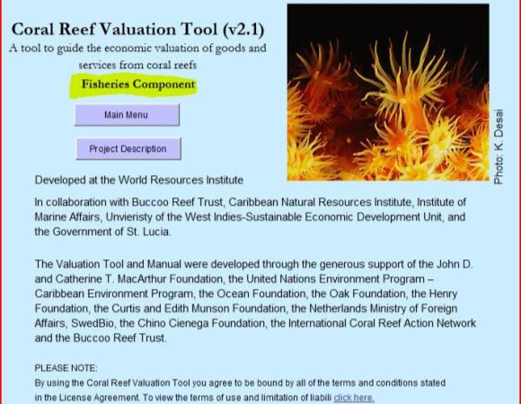
The Methodologies
Methodology | Source
Value Transfer - Spatial Distribution of Ecosystem Service Values | Troy/Wilson
Coral Reef Valuation - Tourism & Recreation | World Resources Institute
Coral Reef Valuation - Fisheries | World Resources Institute

Slide 5
Methodology Comparison
Similarities
  Purpose/Intent – Quantify the financial value/contribution of ecosystem services towards the local economy
Differences
  Scope – Coral Reef specific vs All habitats
  Medium – Graphic vs Numeric
  Inputs – Research vs indigenous knowledge
  Scenarios – Dynamic analysis vs static assessment

Slide 6
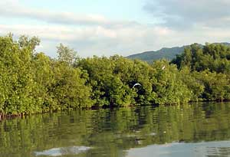
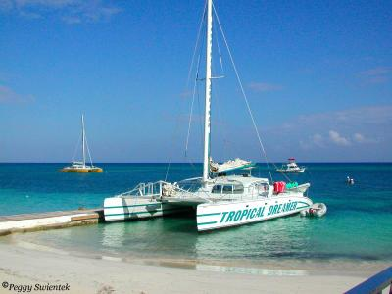

Value Transfer
Adapted from: Austin Troy, Matthew A. Wilson
ECOLOGICAL ECONOMICS
Mapping ecosystem services: Practical Challenges and opportunities in linking GIS & Value Transfer

Slide 7
Theory
Total Value
Habitat Type 1 Value
Habitat Type 3 Value
Habitat Type 4 Value
Habitat Type 2 Value
Values of different habitats are determined
Habitat areas are calculated using GIS
Total ESV is determined by combining values

Slide 8
Overview
Process
GIS used to outline ecological resource types
Spreadsheets to multiply resource area against multiplier ($ contribution/hectare/yr)
Strengths
Relative Simplicity
Tools - Open source (Coral Point Count) vs Commercial (Google Earth Pro; ESRI)
Data - Not heavily dependent upon external data sources - “involves the adaptation of existing valuation information to new contexts where valuation data is absent or limited”
Visual outputs - Graphic outputs readily interpreted and multi-purposed
Weaknesses
Value Multipliers not universally applicable
Development of new multipliers is an extensive undertaking

Slide 9
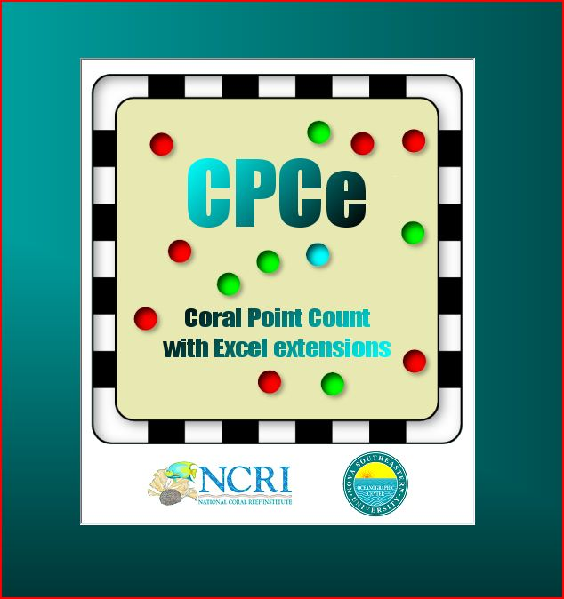
Coral Point Count
Notes:
CPCe developed and maintained by:
Kevin E. Kohler
National Coral Reef Institute
Nova Southeastern University Oceanographic Center (NSUOC)
8000 North Ocean Drive, Dania Beach, FL 33004
kevin@nova.edu

Slide 10
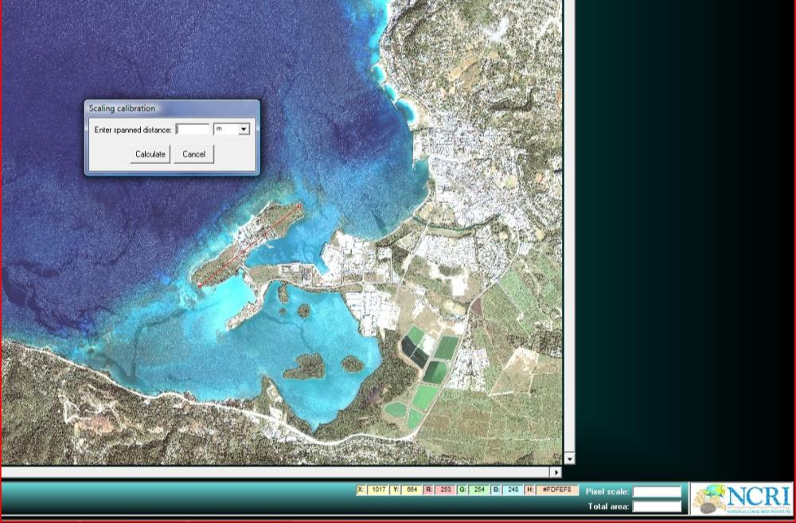
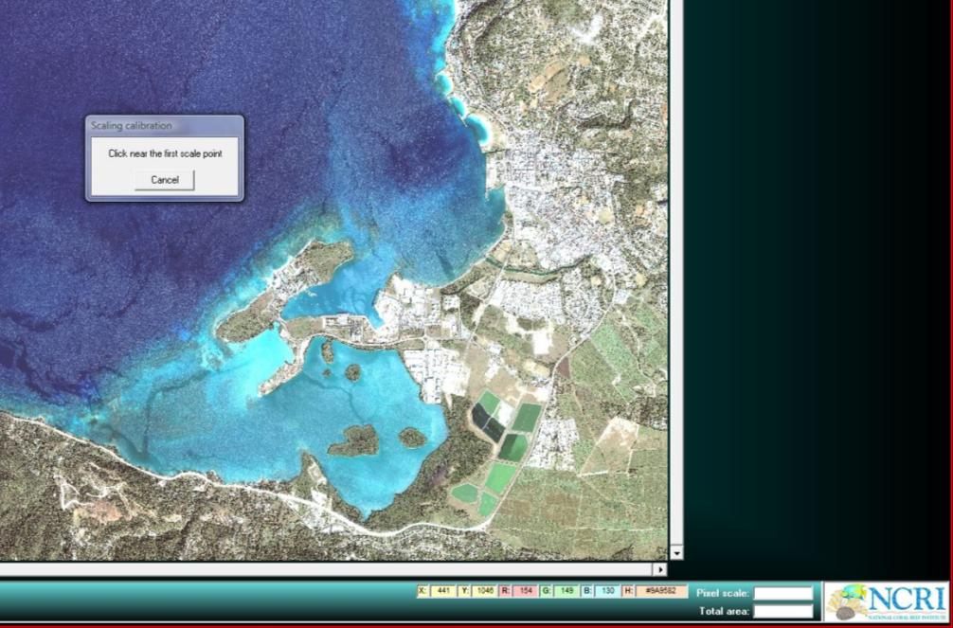
Calibrate
Notes:
To generate area or distance calculations, an initial calibration is required. In the current case, my calibration point was Seawinds Peninsula. Measured from the southwest beach to the northeast beach - First in Google Earth, which provided the distance in meters. After entering the same points in CPC, I entered the figure provided by Google Earth.

Slide 11
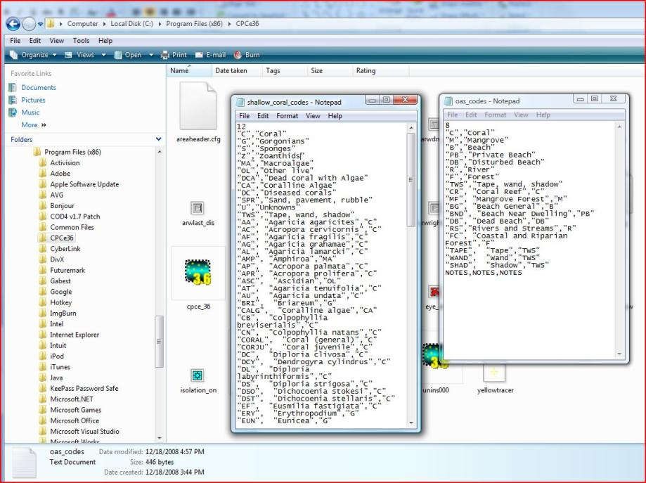
Create categories
Notes:
Coral Point Count (with Excel extensions) was specifically designed to assist with the survey of coral types from underwater imagery. As such, a number of specific coral species have been included in the software, which are also pegged to a specific color set. In order to configure the software using our own categories (habitats vs. coral species), we must first modify the configuration file located in the installation directory of the programme (in this case: C/program files (x86)/CPCe36).
Establishing habitats requires modifying our categories to “trick” the software into thinking that each of our habitats is effectively a specie type. To do so, we must first mimic the family category. You can see from the example that this has been done by duplicating the habitat name.
Other category items (Tape/Wand/Shad) are required for the software to work correctly.

Slide 12
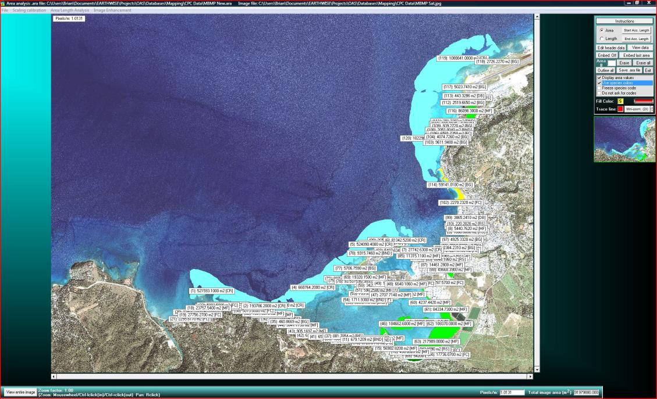
Outline Areas

Slide 13
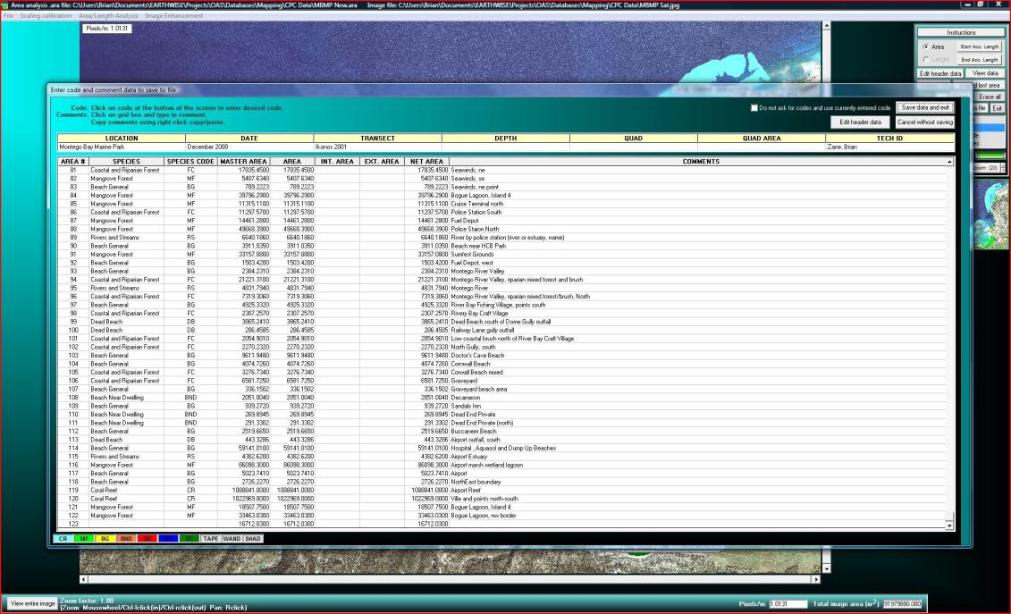
Define Areas
Notes:
While the “comments” section may not be required within CPC (while working within the software), they become highly relevant when working with exported figures in Excel (when you cannot see area numbers over specific outlines). This also gains relevance when considering future valuations (areas may change, be developed, etc.).

Slide 14
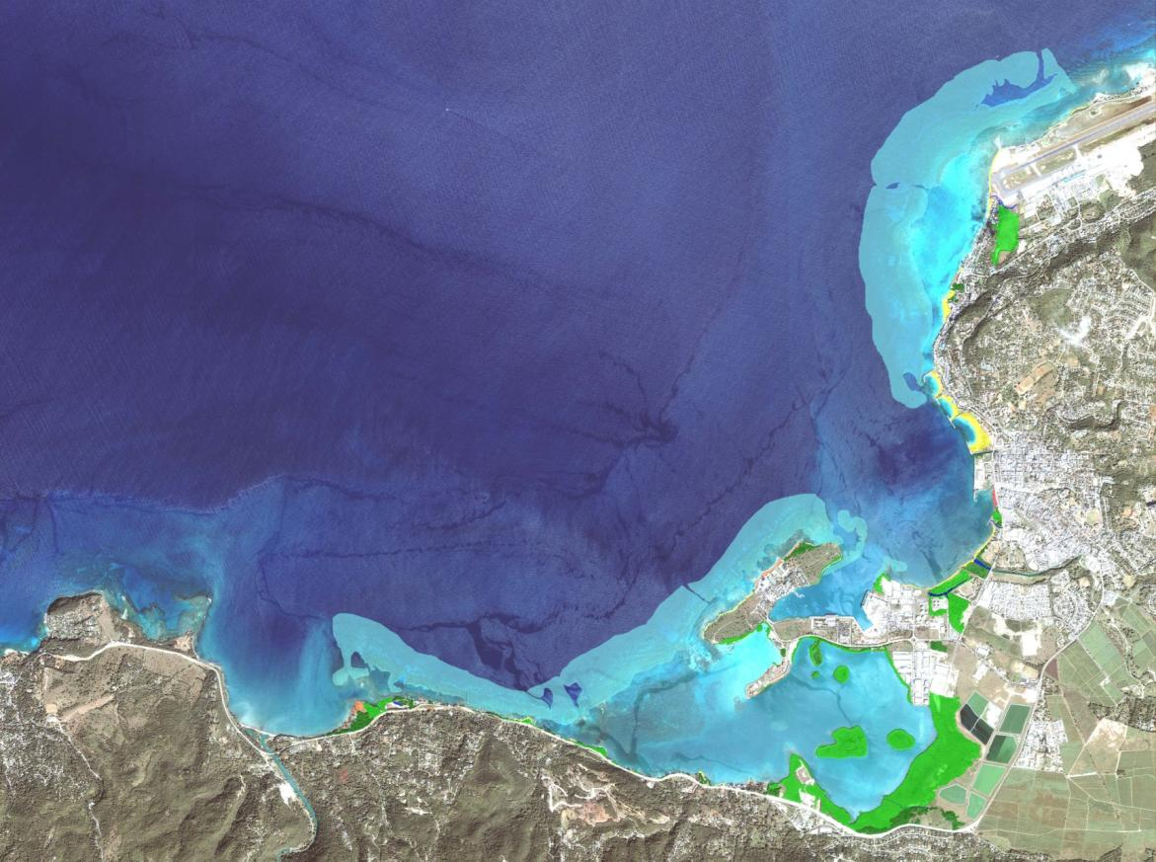
Value Transfer - Results

Slide 15
Value Transfer - Results
Ecosystem Type | $/ha/yr | Total Hectares | Total Contribution
Beach | $88,000 | 10.92 | $960,849.54
Beach Near Dwelling | $117,000 | 3.47 | $405,493.69
Urban & Disturbed Beach | $0 | 0.46 | $0.00
Coastal Forest | $1,826 | 23.41 | $42,749.49
Coral Reef | $100,000 | 422.27 | $42,226,522.50
Mangrove | $37,500 | 108.61 | $4,072,913.20
Rivers, Streams, Freshwater | $1,595 | 2.10 | $3,348.74
MONTEGO BAY MARINE PARK - TOTAL ESV |  |  | $47,711,877.16
Notes:
Habitats for which we did not have multiplier coefficients: grass/shrubland and seagrass beds. Both habitats exist in notable amounts and should also be incorporated in future valuations.

Slide 16
Distribution of Values
Notes:
Despite abundance of Mangroves (25% of the total calculated area of Coral Reefs), they represent only a fraction of the $ value of corals, due to the lower multiplier value.

Slide 17
Summary
Pros
  User friendly
  Necessary inputs are free and readily accessible
  Low dependence on external/hard to locate data sources
  Produces both graphic and numeric results
Cons
  Multipliers (values) developed for NE United States
  Not all local habitats represented
  Challenging to develop local values, which are critical to the accuracy and validity of the tool
Notes:
Discussion
Higher values for beaches?
Urban & Disturbed Beaches - Buffer zone value? Currently set at $0/hectare/yr

Slide 18
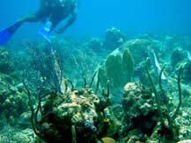
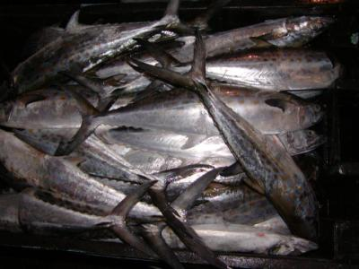
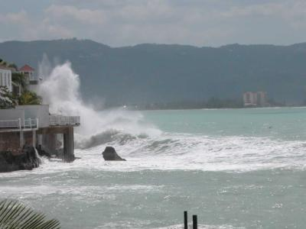
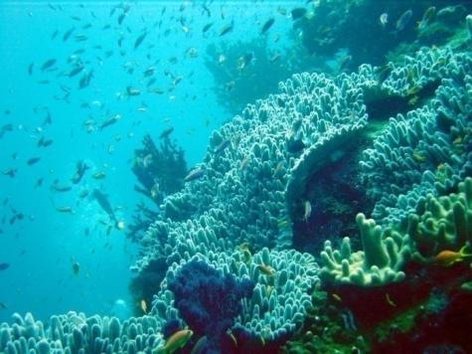
World Resources Institute
Coral Reef Valuation

Slide 19
Theory
Fisheries
Tourism & Recreation
Shoreline Protection
Economic Valuation of Coral Reefs
Notes:
The World Resources Institute has developed a comprehensive methodology for calculating the economic value of Coral Reefs against three primary indices: Tourism and Recreation; Fisheries production; and Shoreline Protection.
As suggested by the title: “Economic Valuation of Coral Reefs”, this methodology focuses primarily on the role played by Coral Reefs. In contrast to the previous methodology, which focused on a range of habitats within the coastal zone, WRI drills down into sectoral benefits of the Coral Reefs.
A second substantial difference between the two approaches is the level of formal data required. This will become more apparent as we move forward through the WRI methodology.

Slide 20
Overview
Process
Review spreadsheets & manuals
Analyze Data requirements
Collect Data
Enter data, review results, modify, review, modify…
Calculate scenarios
Strengths
Highly detailed results
Triangulates ESV of coral reefs
Tools – MS Excel
Weaknesses
Data - Heavily dependent upon external data sources
Aspects not yet developed (Coastal Protection)
Dependencies/Assumptions (built into formulas)
Complexity reduces probability of widespread adoption

Slide 21
Coral Reef Valuation - Tourism
Category | Value
1. Accommodation | $109,425,592
2. Diving | $588,430
3. Snorkeling and Boating | $6,830,932
4. Marine Parks | $0
5. Other Direct Expenditures - Total Value | $0
TOTAL DIRECT ECONOMIC IMPACTS | $116,844,954
6. Total Indirect (secondary) Impacts (from multipliers) | $0
TOTAL DIRECT AND INDIRECT IMPACTS | $116,844,954
7. Un-captured Value
Local Use of Coralline Beaches | $2,457,000
Local Use from reef recreation | $13,650
TOTAL IMPACT OF REEF-RELATED TOURISM AND RECREATION | $119,315,604
Notes:
Numbers consolidated from Tourism Valuation spreadshee/sub-categories eliminated to preserve space.

Slide 22
Anomalies – Marine Park Revenue
Marine Park Category (Zero Rated) – WHY?
  No conventional cost recovery mechanisms (reflected in the tool) are currently implemented in the park.
Visitor Fees
  Entrance – No single entry point
  Diving – No fees in place
  Snorkeling – No fees in place
  Concessions – No concessions in operation
Vessel Fees
  Entry – Collected & held by Port Authority (no estimate available)
  Mooring – No fees in place
Other Fees
  Fishing Permits (Fisheries Division)
  Research Licenses (NEPA)
Areas where Park Manager has recuperated operational expenses:
Beach Fees
  ~US$7,000 (3 or 4 disbursements since park inception)
Management Fee
  ~US$40,000/yr (Pegged to management agreement; two years since inception)
National Park Trust Fund
  ~US$25k – 35k (every second/third year depending on interest earned by fund)
Each allocation changes in frequency and amount, and doesn’t fit into provided categories and therefore was not included.
Notes:
Marine Parks – Demonstrate $0 as none of the conventional methods of cost recovery (included within the tool) are implemented by the Park. Important to note that the Marine Park Trust (Park Manager since inception) has had to cover overhead expenses through project activities.
Notable inputs (for which there is no place to include within the tool) include intermittent Beach Fee subsidies remitted by the national body (National Environmental Protection Agency), approximately US$7,000 once every other, or third year; Management Fee (infrequent; two or three years since park inception, ave of US$50,000/yr), and; Interest payments from the National Park Trust Fund (again, infrequent and usually to the tune of JA$ 2- 3 million; US$25,000 - $35,000).

Slide 23
Anomalies - Undervaluation
Cruise Ships
Estimated +150,000 visitors to Montego Bay not accounted for
Cruise Ship calculations not included; tool not yet developed
Would push overall valuation figure up
Coastal Protection
Third valuation tool not yet developed
Would add critical third figure to overall Coral Reef Valuation figure
Multiplier
Total Indirect Impacts
Function did not work

Slide 24
Coral Reef Valuation - Fisheries
Category | Value
1. Commercial Fisheries | $0
1a. Fish Processing and Cleaning | $0
3. Local Fishing | $1,128,700
TOTAL IMPACT OF REEF-RELATED FISHING | $1,128,700
Notes:
There is no commercial fishery in Montego Bay. As such, total contribution has been calculated at $0.
WRI spreadsheet requires entries so as not to produce division by zero results. To overcome obstacle, ones (1) were entered in each line item and then physically manipulated in exported spreadsheet.

Slide 25
WRI Valuation - Totals
Tourism: US$119,315,604
Fisheries: US$1,128,748
Coastal Protection: (N/A)
  $120,444,352

Slide 26
Coral Reef Valuation - Process
Coral Reef Valuation – Tourism
Coral Reef Valuation – Fisheries
Coral Reef Valuation – Coastal Protection
Notes:
Links page to access spreadsheets for step-by-step walk through of each tool

Slide 27
Results Comparison
Methodology | Source | Value
Tourism | Spatial | N/A
 | WRI | US $119 million
 | WB | US $210 – 630 million
Fisheries | Spatial | N/A
 | WRI | $1,128,748
 | WB | US ($1.66m) – $7.49 million
Coastal Protection | Spatial | N/A
 | WRI | N/A
 | WB | US $65 million
Value Transfer | Troy/Wilson | US$47 million
Notes:
Important:
World Bank Methodology serves as our benchmark – 4 year study benefited from NRM specialists, economists and social scientists.
WRI and WB methodologies specifically calculated economic value of Coral Reefs, whereas Value Transfer methodology calculated all habitats within the marine park.
Discrepancy between contributions most readily explained as follows:
WRI Methodology:
Excluded cruise ship passengers
Third Tool (Coastal Protection) – Not yet available
Value Transfer:
Figure is low, most likely due to multipliers/coefficients being incorrect. Area calculations had a high degree of accuracy based on 2001 Sat image and should therefore be much closer to, if not higher than World Bank results.

Slide 28
Discussion
Preferred Methodology?
Data Requirements
  Sources
  Relevance
  Date
Considerations for broader use
  Stakeholders
  Results Sharing
  Database Integration
  Willingness, Value, Application, Acceptance

Slide 29
Thank you!

Slide 30
Results Comparison (Alt. View)
Methodology | World Bank | WRI | Value Transfer
Tourism | $210 – 630 million | $119 Million | N/A
Fisheries | ($1.66) – $7.49 million | $1,128,748 | N/A
Coastal Protection | $65 million | N/A | N/A
Value Transfer | N/A | N/A | US$47 million
* All figures in US Dollars
Notes:
Important:
WRI and WB methodologies specifically calculated economic value of Coral Reefs, whereas Value Transfer methodology calculated all habitats within the marine park.
Discrepancy between contributions most readily explained as follows:
WRI Methodology:
Excluded cruise ship passengers
Third Tool (Coastal Protection) – Not yet available
Value Transfer:
Figure is low, most likely due to multipliers/coefficients being incorrect. Area calculations had a high degree of accuracy based on 2001 Sat image and should therefore be much closer to, if not higher than World Bank results.

Slide 31
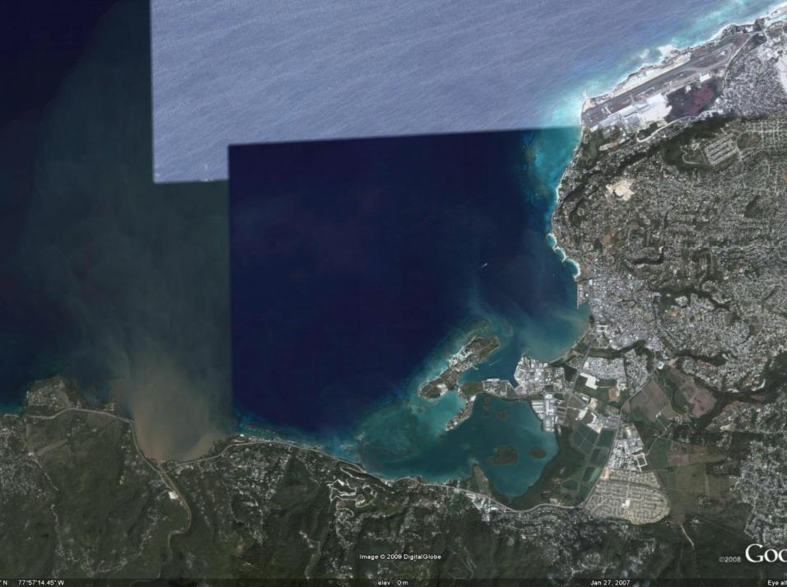
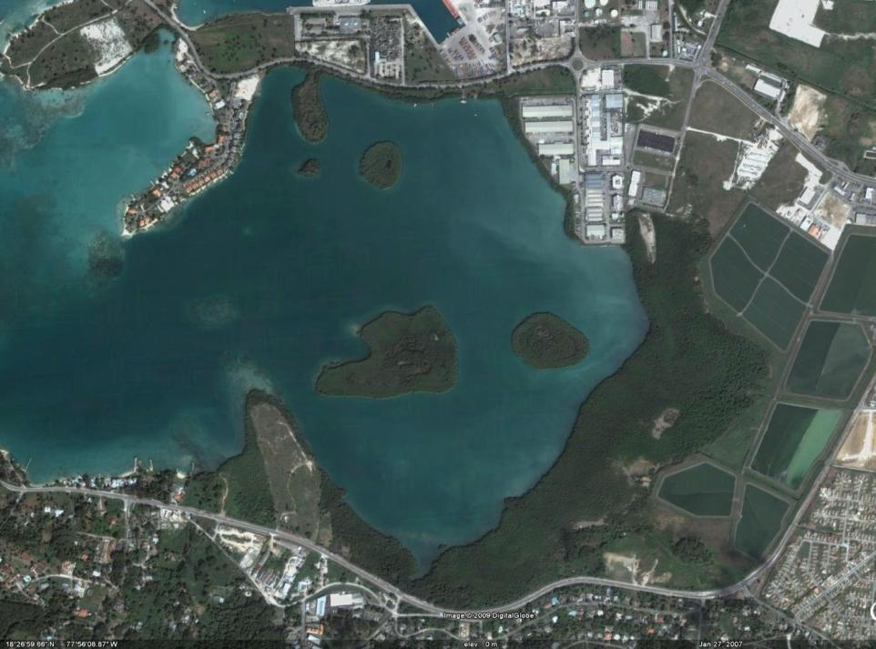
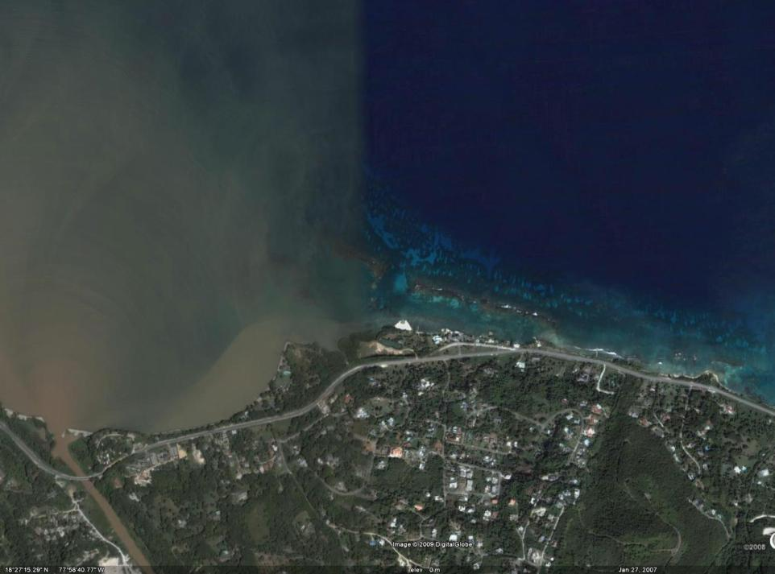
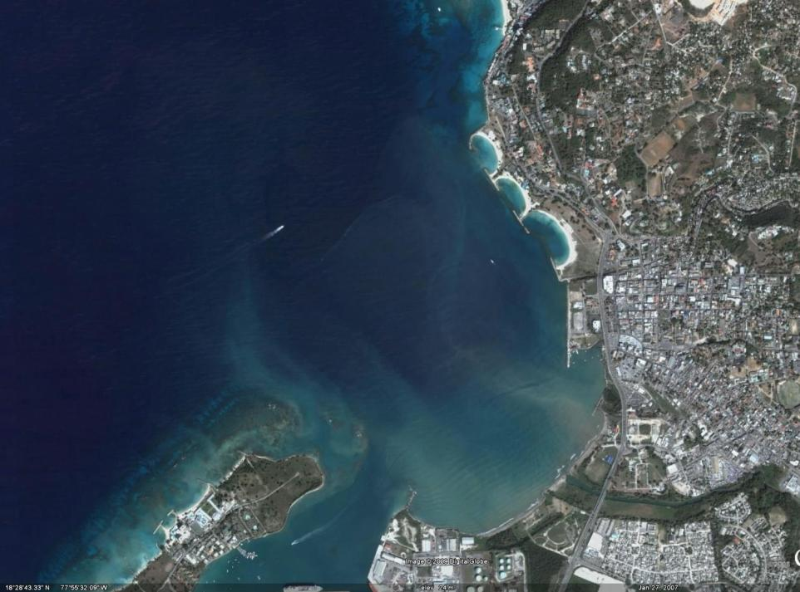
Montego Bay Marine Park
Distinct Features - Google Earth
Marine Park
Bogue Lagoon – Fish Sanctuary
Western Boundary of Park (Great River outflow – sediment plume)
Urban Gully influences

Slide 32
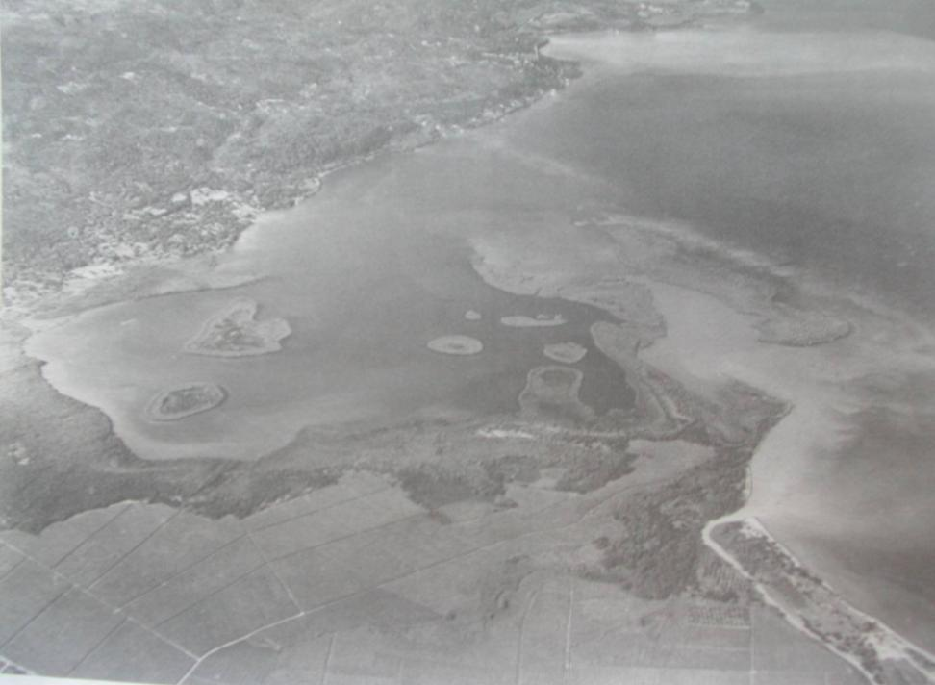
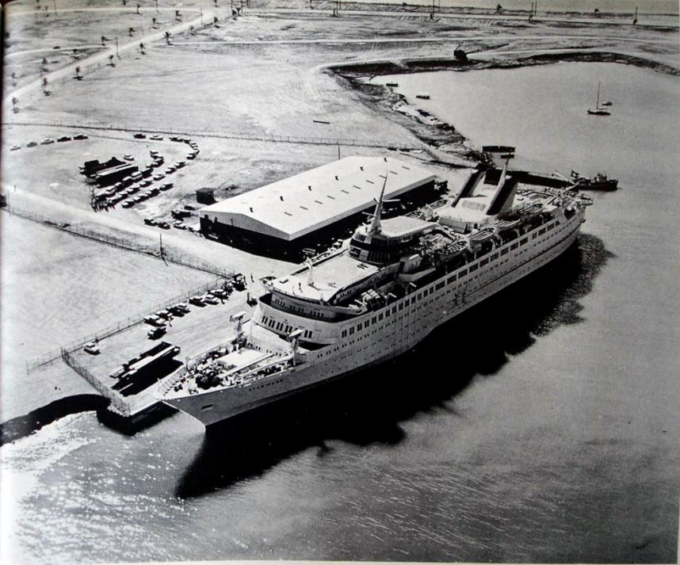
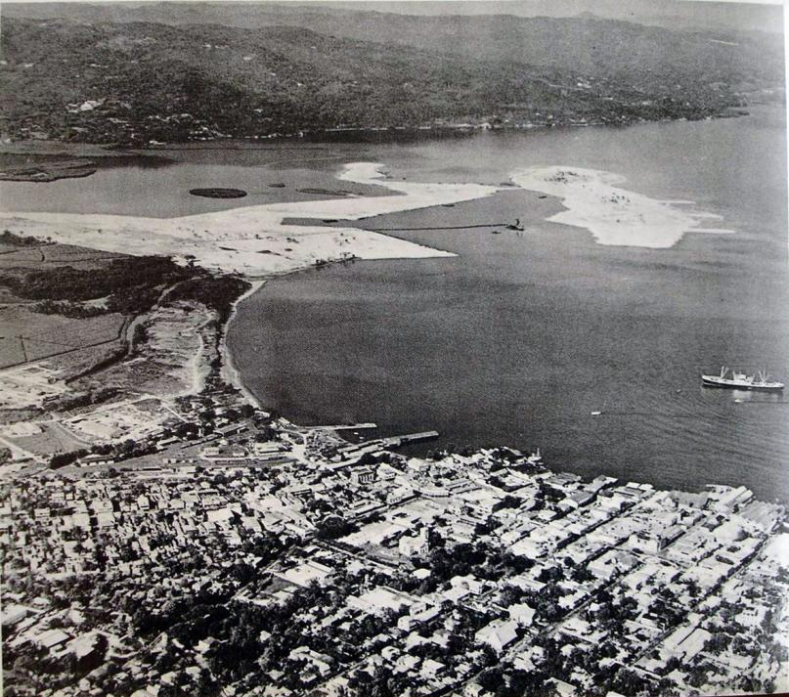
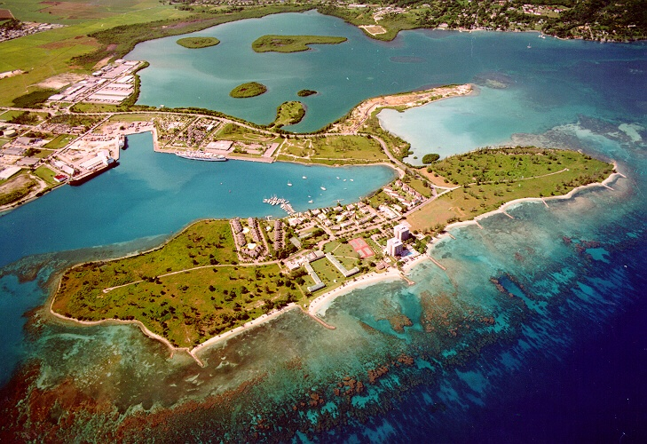
Historical Perspectives
Bogue Lagoon prior to construction
Freeport during construction
Cruise Terminal
Freeport/Lagoon 1990s

